Slide 1


Plotting – part 1
A guide to make figures in Python

Slide 2


Popular plotting libraries
Matplotlib: library for 2D plotting
Seaborn: statistical data visualization; easy integration with Pandas dataframes
Installation into conda environment:
conda activate environment
pip install matplotlib seaborn

Slide 3
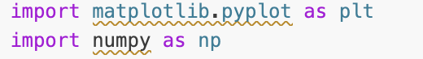
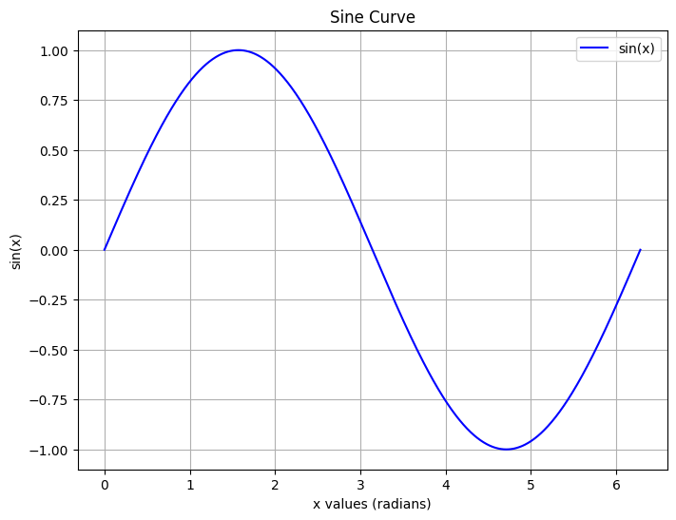
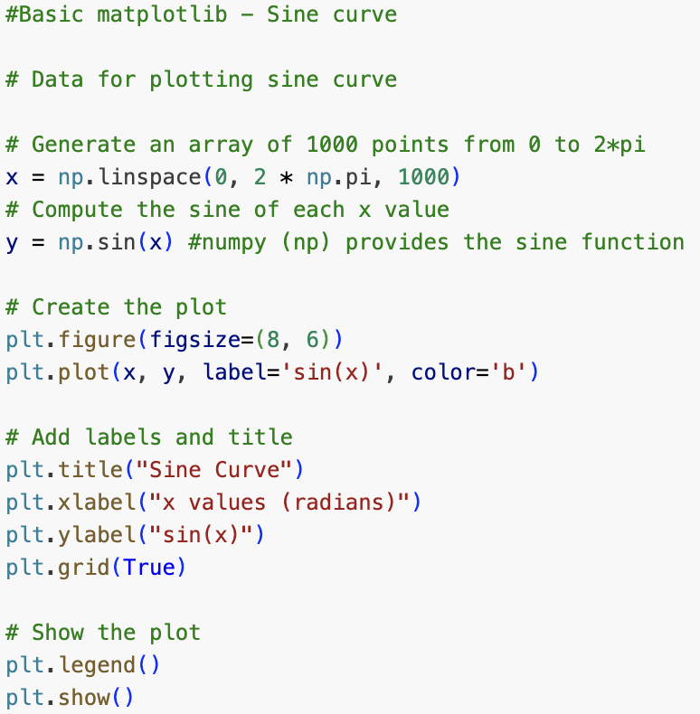
Matplotlib – example sine curve
Numpy provides pi value
Import libraries
Code to produce graph on the right

Slide 4
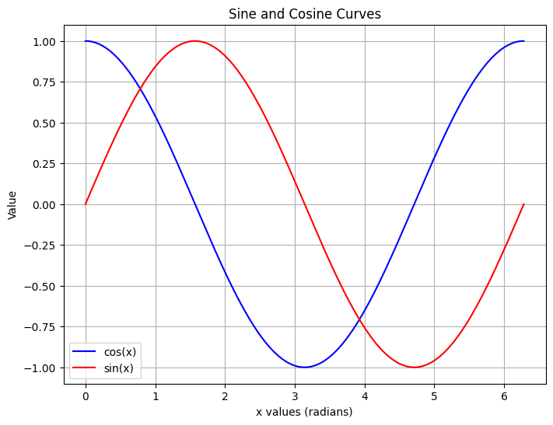
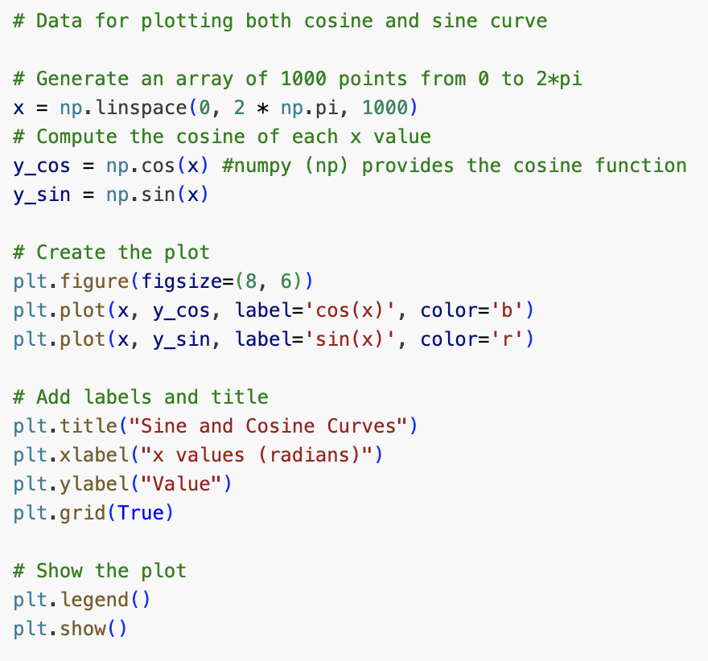
Matplotlib - example sine and cosine curves
Import libraries
Code to produce graph on the right

Slide 5
Matplotlib plot types
Line plots: plt.plot()
Scatter plots: plt.scatter()
Bar plots: plt.bar()
Histogram: plt.hist()
Customization
Add axis labels: plt.xlabel(), plt.ylabel()
Add title: plt.title()
Change figure size: plt.figure(figsize=(width, height))
Add a legend: plt.legend()
Compact layout: plt.tightlayout()
Useful links:
https://matplotlib.org/stable/api/pyplot_summary.html

Slide 6
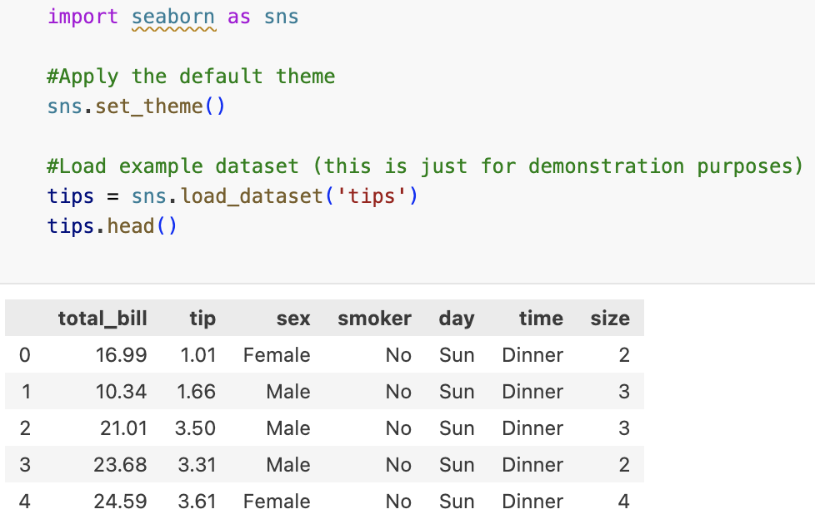
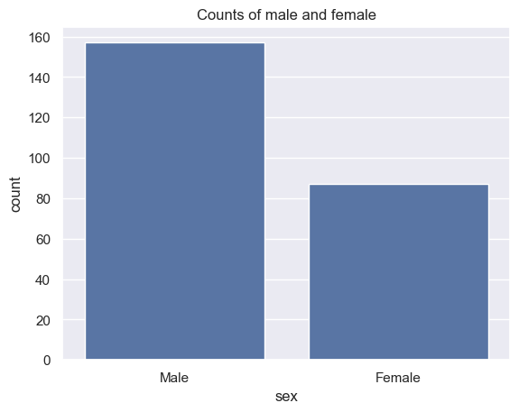
Seaborn - examples
The five first rows of the example dataset
Column to be graphed
The dataset with the relevant column
Set the title for the plot

Slide 7
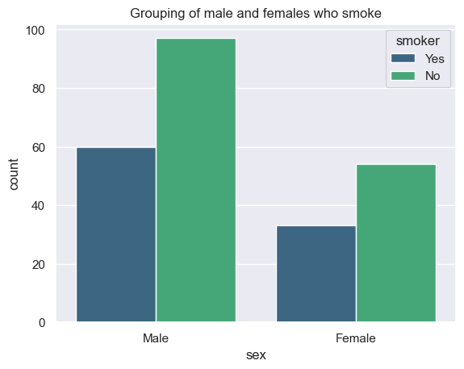
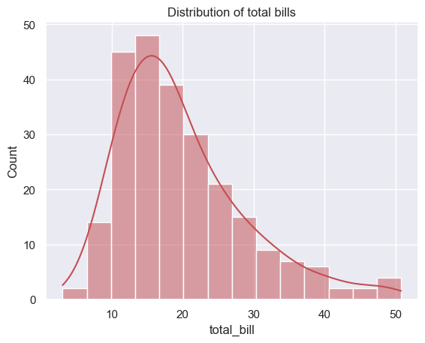
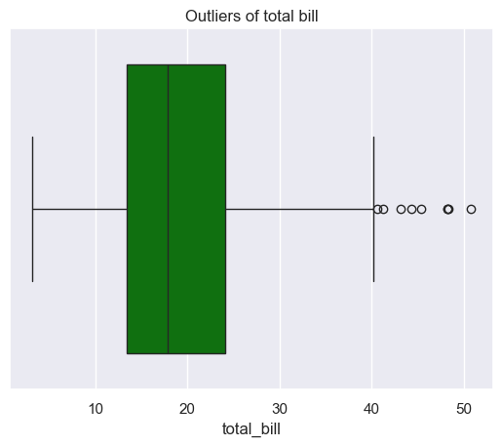
Seaborn - examples
Colour palette
The column from tips dataset for the plot
Grouping of data based on a column in the dataset which contains categorical variable
Add the estimate curve
Function for boxplot
Function for histogram

Slide 8
Seaborn plot types
Scatter plot: sns.scatterplot
Line plot: sns.lineplot
Box plot: sns.boxplot
Violin plot: sns.violinplot
Barplot: sns.barplot
Countplot: sns.countplot
Histogram: sns.histplot
Scatter plot with regression line: sns.regplot
Heatmap: sns.heatmap
Helpful links: https://seaborn.pydata.org/tutorial.html
https://www.geeksforgeeks.org/introduction-to-seaborn-python/

Slide 9
Matplotlib: Use the following data:
courses = ['Math', 'Physics', 'Chemistry', 'Biology', 'Computer Science’]
students = [120, 85, 95, 75, 150]
Create a bar chart to represent the number of students in each course
Add appropriate labels for the x-axis, y-axis and title for the chart
Challenge Yourself

Slide 10
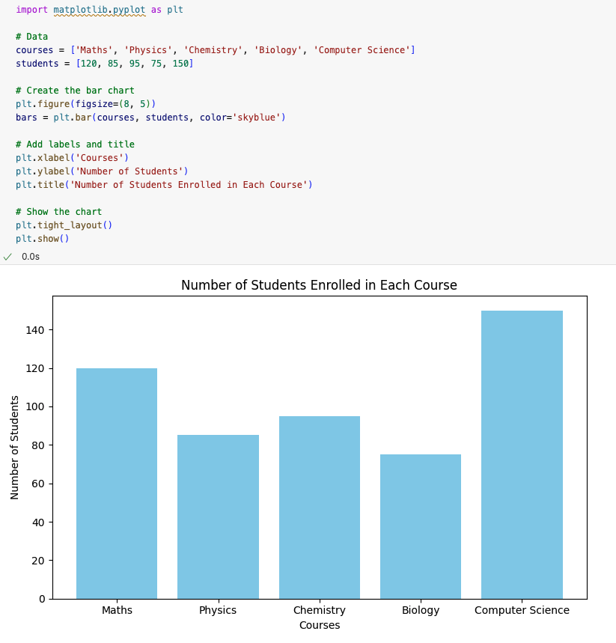


Slide 11
Seaborn: Use the following data:
scores = { 'Math': [78, 85, 92, 88, 76, 90, 85, 88, 79, 84], 'Physics': [67, 72, 75, 80, 69, 78, 74, 77, 73, 70], 'Biology': [88, 82, 91, 85, 89, 87, 86, 90, 83, 88] }
Turn the scores dictionary into a Pandas Dataframe
Hint: Use df.melt(var_name=‘___’, value_name=‘___’) to make compatible with following task.
Create a box plot for the test scores of each subject
Add title and labels for the x-axis and y-axis
Customise the plot to use a specific colour palette
Challenge Yourself

Slide 12
